Slide 1
Spring Boot HATEOAS
Hypermedia As The Engine Of Application State

Slide 2
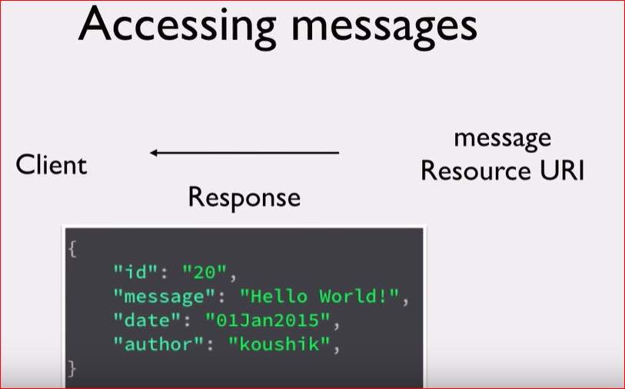
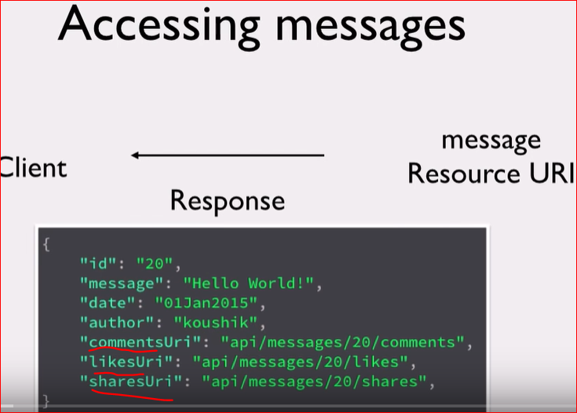

Slide 3
We receive a get request from a client for a message id. The normal api would provide the complete info of the message id. So now what if you can provide links to commentsUri, likesUris, sharesUri
Basically the server says I know you asked for message id 20 now the contents of message id 20 and also providing the collection resources commentes, likes , shares. So if you need a comments of message id 20 you can use the uri if you need likes uri you can use this uri
So the web server is super helpful to the client by providing the links in the response. It’s is similar to hyperlinks in website whether the client wants to use or not that doesn’t matter. If they wanted they can use it from the response.
So the client developer picks up the value from the previous response and makes up the subsequent calls to those URI’s
If you do this we don’t let the client programmer to know or hardcode these URI’s in order to interact with the resources.

Slide 4

So basically let the hypermedia that you send in the response drives the client interaction with the application state
That is how HATEOAS is Hypermedia As The Engine Of Application State
Rel Attribute :
An attribute that you can add to any link to specify the relationship between the current document and the linked document
The most common example of rel is stylesheet . Href here is the actual link to be provided and rel attribute describes the relation of that link to the main document .Use ref attribute to give the extra information in the api response.

Slide 5
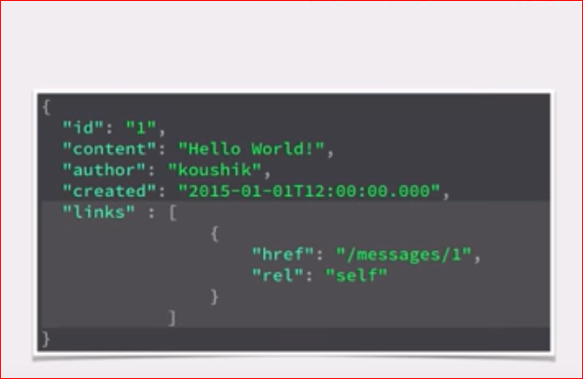
Add rel attribute to make it clear what that it is points to.
Here rel points to self meaning the resources is points to the same content.
https://www.iana.org/assignments/link-relations/link-relations.xml

Slide 6
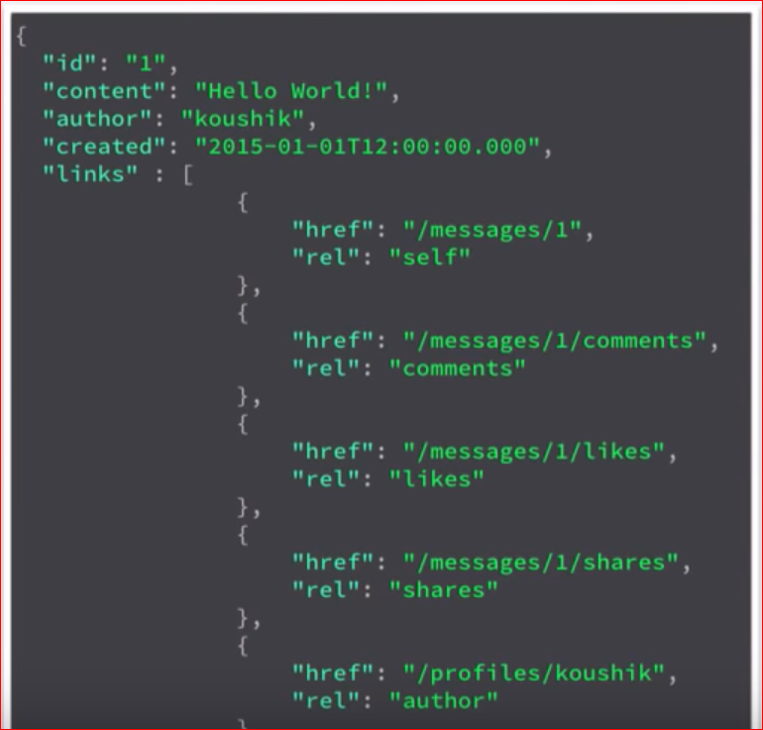
Summary: Hateoas is the way to provide links to resources in the api response. So that the clients need not to form the URI’s
They make a request and they provide the next steps in the response.

Slide 7
